Slide 1
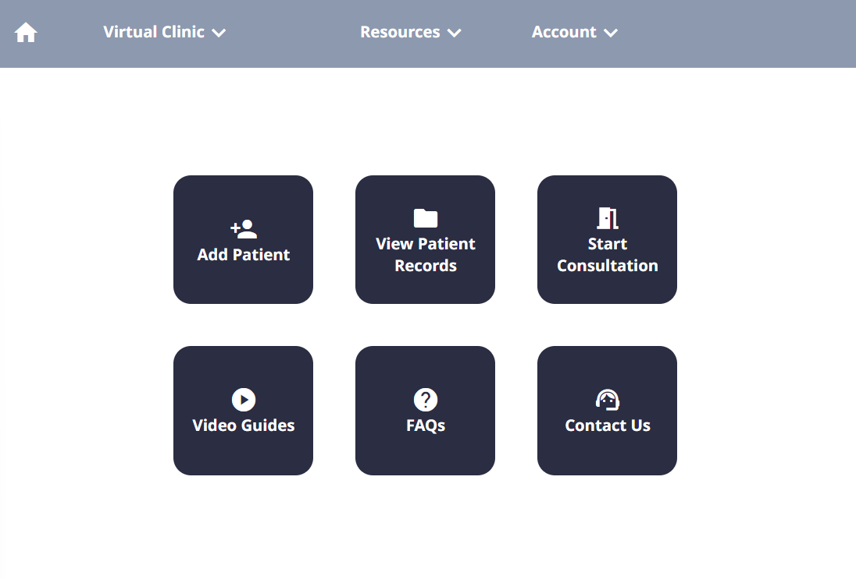
Welcome to Tutorial 2.
We will start by practicing again how to start a consultation.
This time, we will not visit the patient record, but rather go straight into the consult.
Click to continue →

Slide 2
You can start by pressing the ‘Start Consultation’ button.

Slide 3
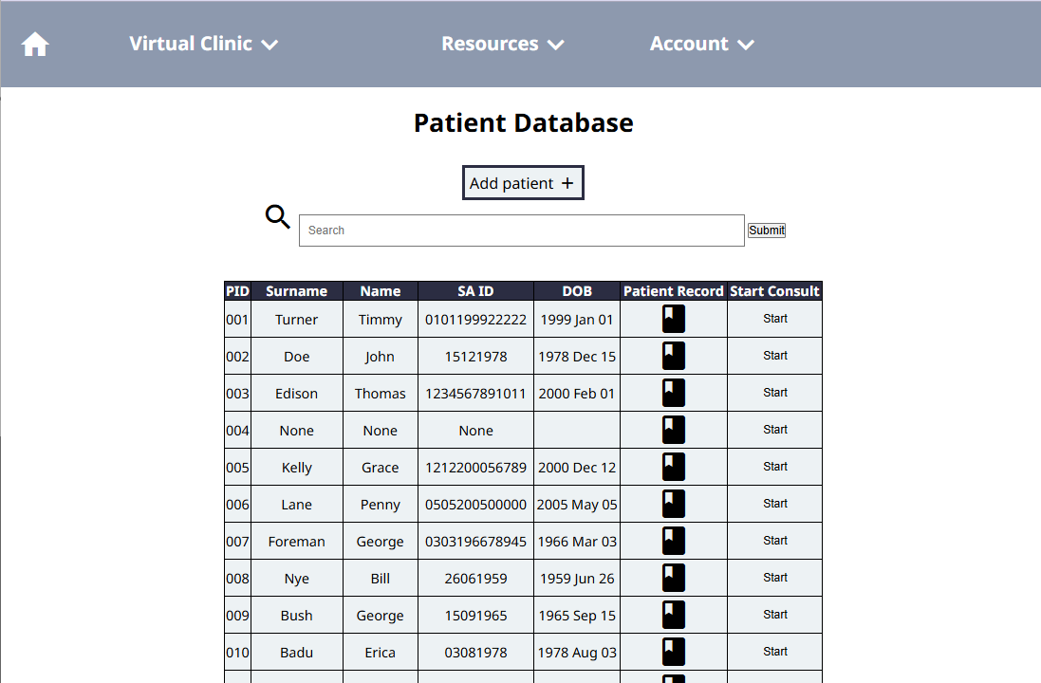
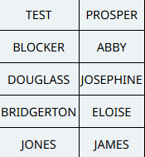
Great. Now, instead of using the patient record button, we’ll use the ‘Start’ button with our patient James Jones again.

Slide 4
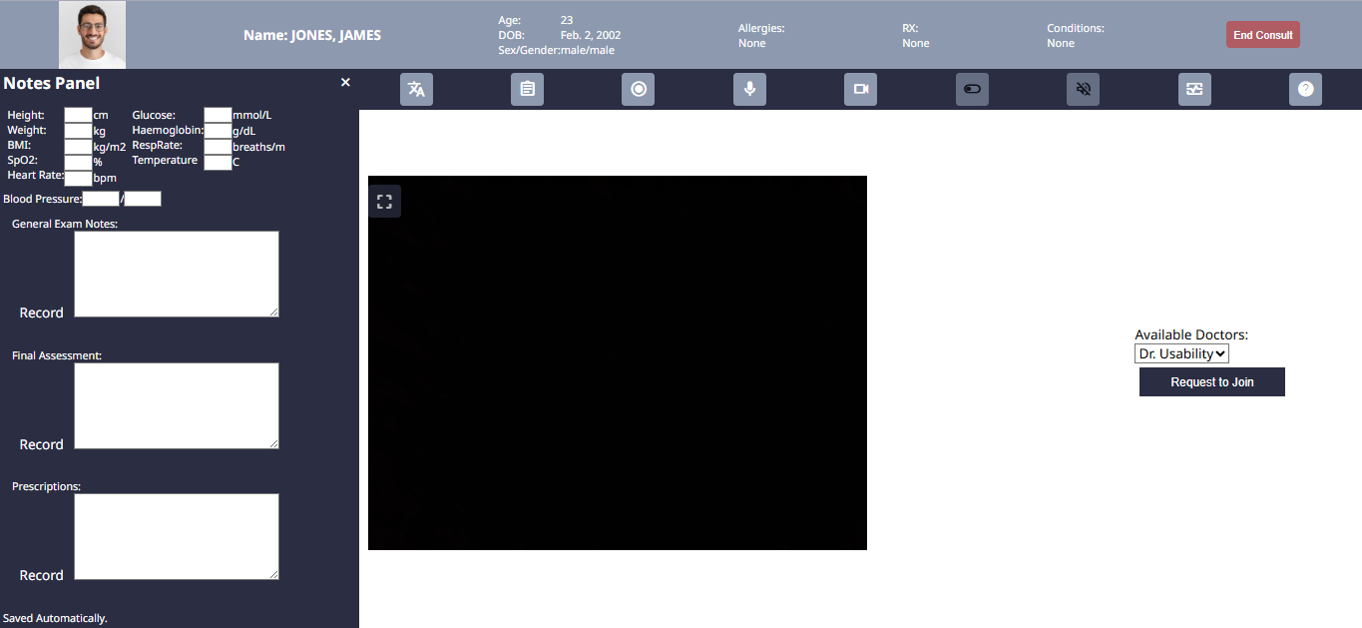
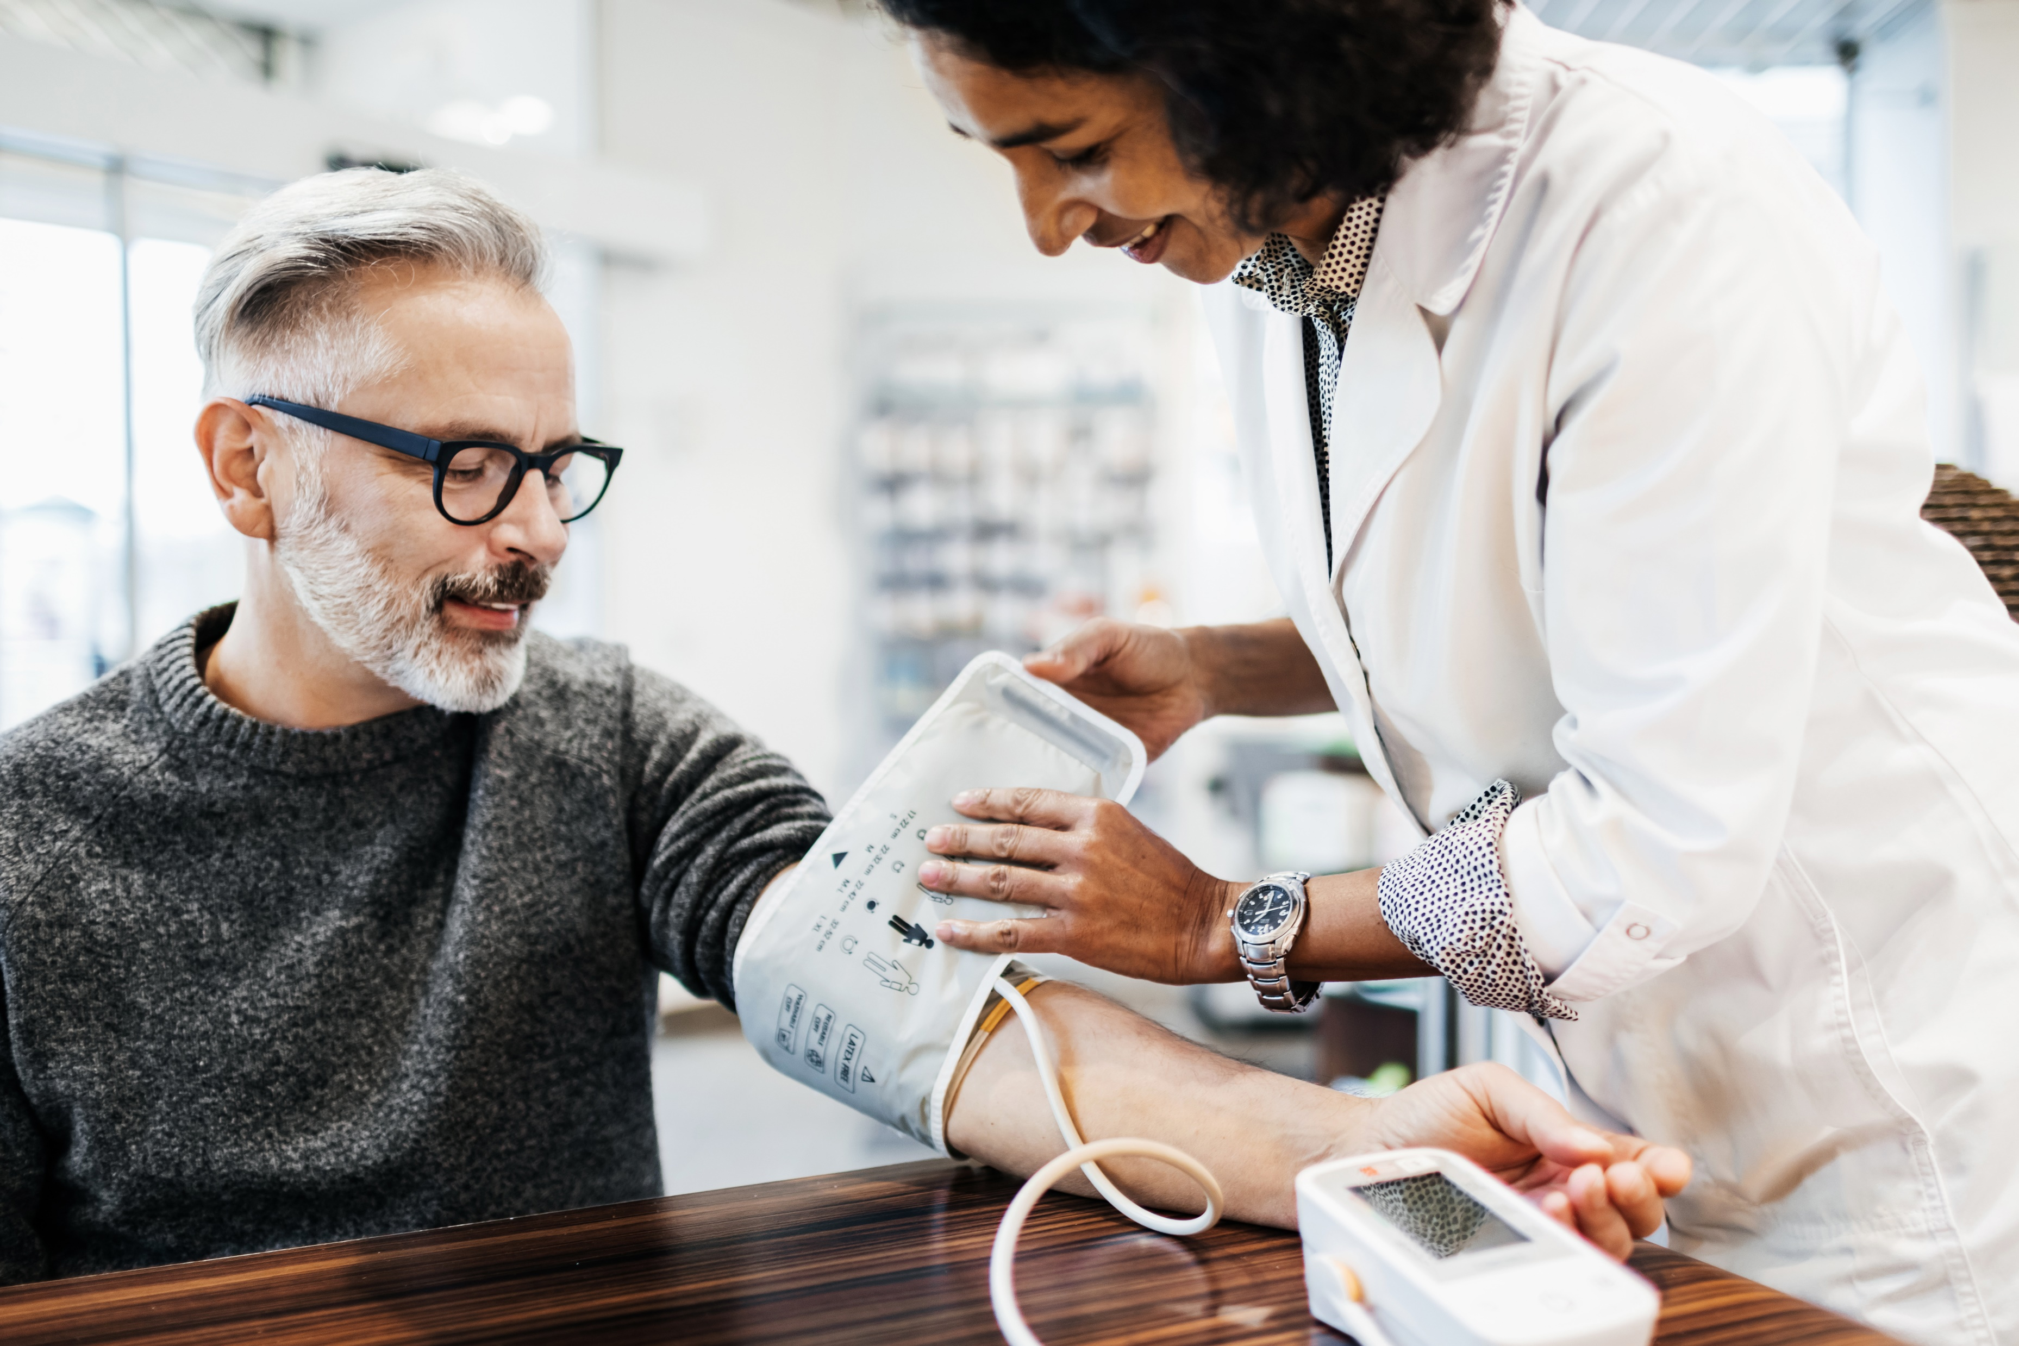

Don’t forget that you’ll need to record each session.
Go ahead and start the recording now.

Slide 5
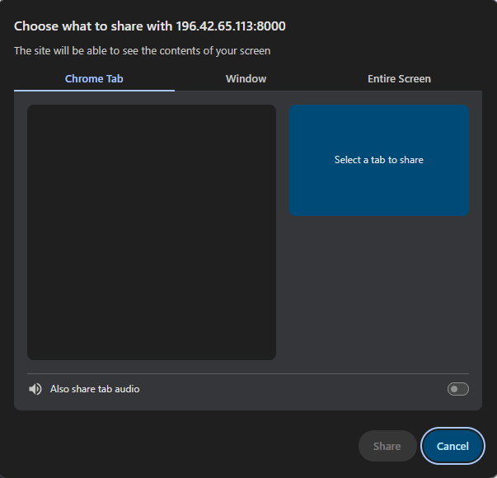

Slide 6
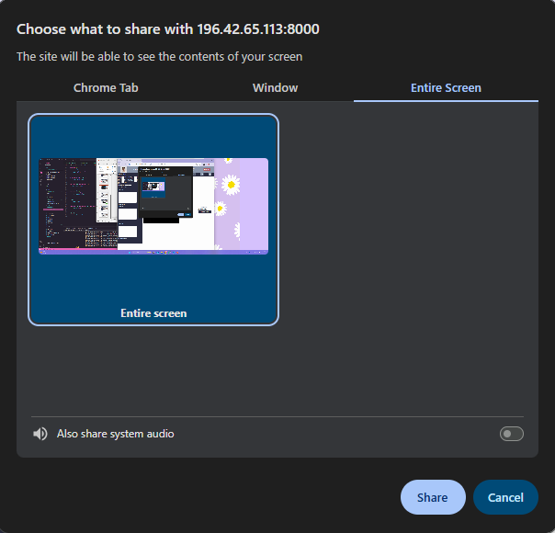

Slide 8


Slide 9
eczema
Great. Now let’s get started.
This time, your patient is complaining of an itchy rash on their arms and chest.
You can see under the ‘Conditions’ heading that they have already been diagnosed with eczema previously.
Click to continue →

Slide 10
The doctor has had the patient describe the symptoms, but would like to see a more detailed view of the skin.
This means you’ll need to use the dermascope to capture images of the patient’s skin.
Click to continue →

Slide 11

Plug in the medical camera to the USB port on the computer.
The medical camera icon will now be enabled.
Click the medical device button to turn on the camera. (hint: it looks like an oval with a circle inside)

Slide 12
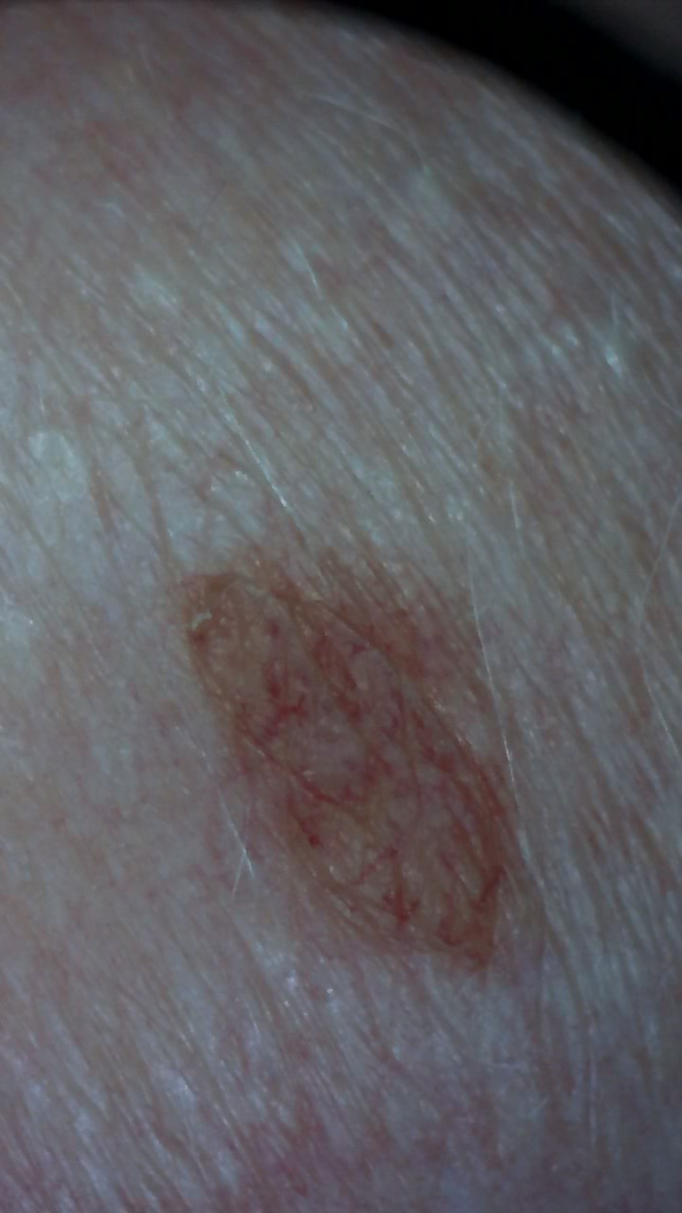
Great! You have now turned on the camera.
Since this tutorial is not live, you won’t see the real images. But, if you want to open the camera app on your device, you can see the image and get comfortable with how the device looks.
For now, there is a sample image provided.
Click to continue →

Slide 13
The doctor prescribes an emollient, and wants to see the patient again in one week if it is not improved.
The doctor also wants to take an image of the skin today, so that it can be compared during the follow-up appointment to see if the prescription is working.
Click to continue →

Slide 14
To take an image from any of the camera views, use the screenshot icon in the top left corner of the video stream that you want to take a picture of.
The picture will automatically be captured and saved to the patient record.

Slide 15
Now that you’re finished with the camera, you can turn it off.
Press the camera button again to turn off the camera, then unplug it from the computer.

Slide 16
Great! The consult is over now. You can end the consult.

Slide 17
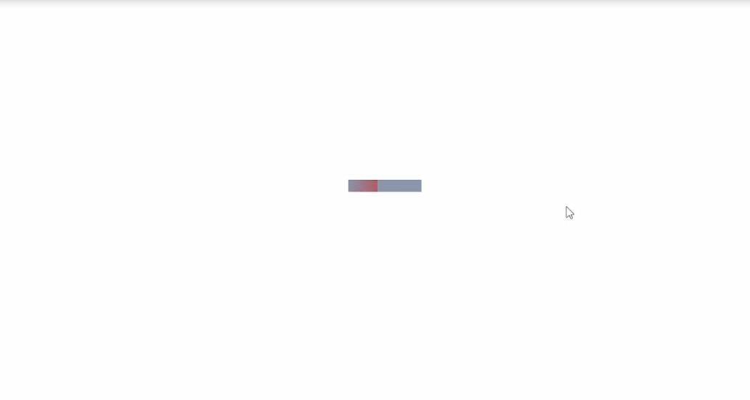
Remember not to exit out or change the page while it’s loading!
Click to continue →

Slide 18
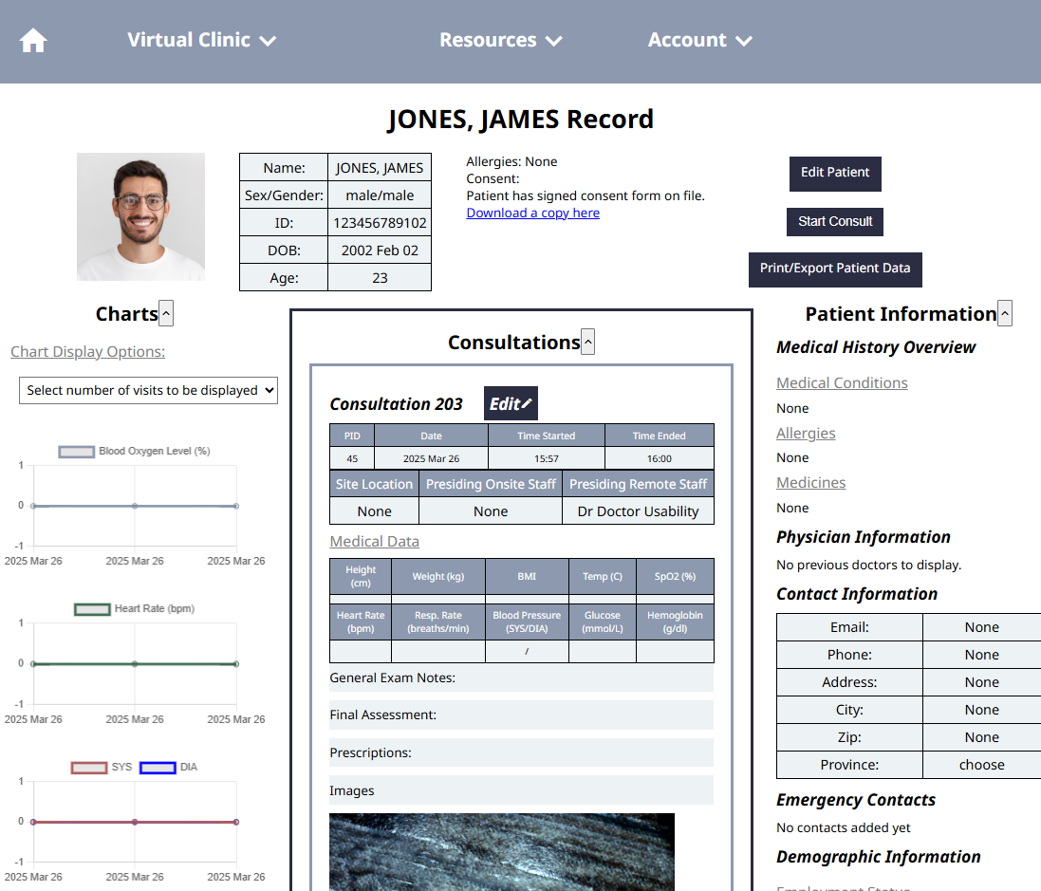
Great! The new image is now saved on the patient’s record.
37
99
120
80
The patient has a suspected migraine. The patient is prescribed to take ibuprofen , 200mg 3x within the next 24 hours. If they are still experiencing issues , they should return to the clinic tomorrow.
Click to continue →

Slide 19
Congrats! You have finished your Tutorial 2.
You now know how to:
Use the medical camera for capturing patient images
Capturing images to the patient record from the video stream.
You are now ready to try Tutorial 3.

